Slide 1




CAPSTONE EDA PROJECT
On
PLAY STORE APPs REVIEW ANALYSIS
Submitted by :
Mujtaba Ali
Kiran Joshi
Prateek Sachdeva
Samrat Chowdhury
Subham Sinha

Slide 2

PLAY STORE APPs REVIEW ANALYSIS

Slide 3

Why review analysis is important?
Play Store place a greater level of importance on ratings and reviews than ever before. Apps with higher ratings and reviews rank high in search. If an app ranks high then there's a better chance of it being found and downloaded. The more downloads the more it will be kept high in the rankings
App Market is set to grow 20% by 2023
Datasets
Two datasets are provided
Basic Information
User Review
It consist of 13 columns: App, Category, Rating, Review, Size, Installs, Type, Price, Content, Rating, Genres, Last Update, Current Ver, and Android Ver
and with 10841 Rows.

Slide 4



Overview Of Analysis
Data Cleaning
Understand the structure of the dataset and clean data before analysis
Data Exploration
Uncover initial patterns, characteristics, and points of interest using visual exploration
Data Visualization
Data visualization using Python visualization libraries like Matplotlib, Seaborn.

Slide 5
Problem Statement
1. Find out the app category which application has been installed maximum number of times.
2. What are the factors affecting the maximum downloads?
3. Exploring the top 5 highest rated free and paid apps.
4. Exploring the average rating for each category.
5. Understanding the sentiment polarity of the users.

Slide 6
Data Visualization
Top Installed Apps By Category
Game, Communication, Social, Productivity, Tools, Family, Photography, News & Magazines, Travel & Local, Video Players are untapped free app categories
High Installs because of a high underlying demand
GAME category apps has been installed maximum number of times

Slide 7
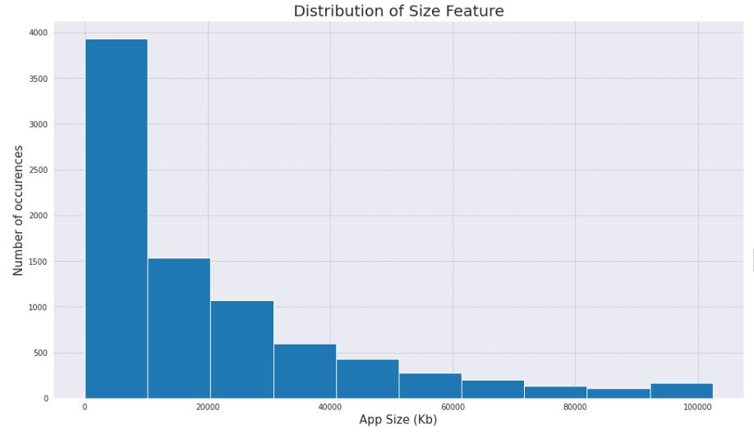
Factors Affecting Maximum Number Of Downloads
The size of app indirectly proportional to No. of Installation.
If the size of app is less than or equal to 10MB then there is high chance to install that application.

Slide 8
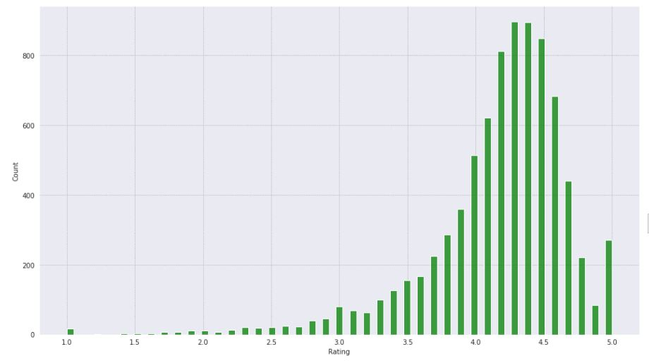
Impact of Rating to Number of Installations
The maximum number of downloads are roughly between 4.0 to 4.6 ratings

Slide 9
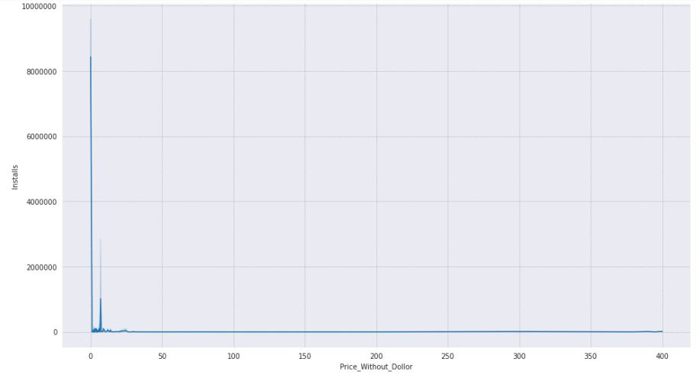
Price-Installations correlation
If the app is free to use then there is high probability to install.
Paid apps are less likely to be installed.
For the paid apps category maximum Installations are upto 20 dollars only.

Slide 10
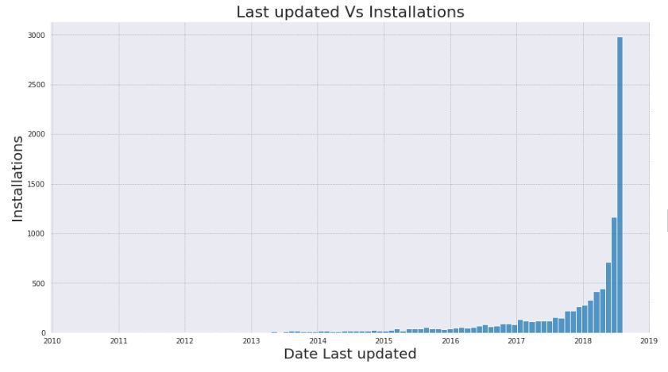
If app developers are updating their app regularly then there is high chance to install.
As you can see in histogram, developer should give updates more frequently.

Slide 11
Free vs Paid Apps
92%
of apps on play store are free to download and rest are paid

Slide 12
Top 5 Highest Rated Paid and Free Apps:
Top 5 Highest Rated Free Apps
DF Glue Board
CN Resident
CL Strength
Color CL
CP Trivia
Top 5 Highest Rated Paid Apps
USMLE Step 2 CK Flashcards
211:CK
30WPM Amateur ham radio Koch CW Morse code tra...
Morse Player
AC DC Power Monitor

Slide 13
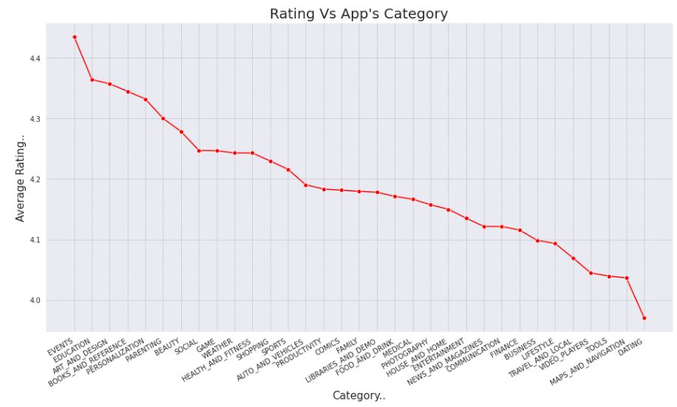
Average Rating For Each Category
EVENT category has the maximum number of average rating.

Slide 14
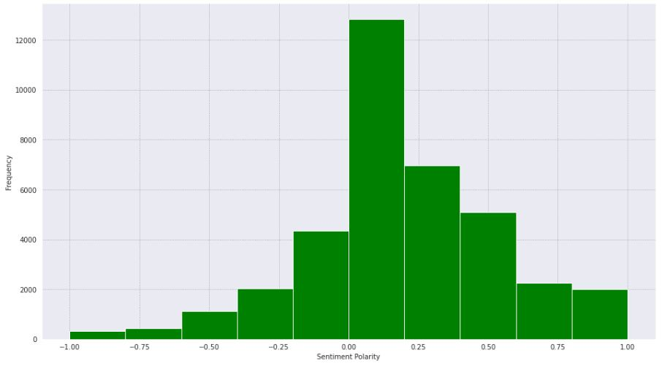
Sentiment Polarity Of Users

Slide 15
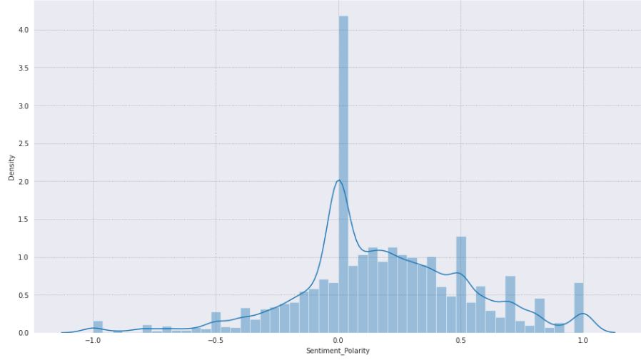
Maximum Apps around 40000 apps reviews Sentiment polarity lies between 0.0 to .18 (Neutral to towards Positive)
Around 3000 apps reviews Sentiment Polarity lies between -1 to 0.0 means About 3000 apps have negative sentiment polarity.
Mostly Apps Sentiment polarity lie between -0.47 to +0.8

Slide 16
Summary
Size
Highly rated apps were optimally sized between 2MB to 40 MB
Paid apps with specific functionality were lighter
Price
Free apps outperform paid apps
If an app is paid, the likelihood of it being popular is higher if it’s priced under $10
Rating
Positive relation between installs and rating.
However, highly installed apps are not always highly rated.
Review
Issues like loading time and positive features like usability were revealed by sentiment analysis.

Slide 17
Conclusion
Results we got as per our analysis :
GAME category has the most number of downloads and ratings, and EVENT category has the maximum number of average rating.
The size and free/paid apps category affected the maximum number of downloads.
Users prefer to pay for apps that are light-weighted. As app size get larger conversion rate decreases.

Slide 18
Q&A

Slide 19
Thank You

